Slide 1

Market Pain: What's Wrong Today?
Chip factories and data centers can consume 100 times more power than a typical industrial business. WSJ 2024-03-29
The market lacks nanosecond, energy efficient database systems.
Highlighted by advancements in GPU and ASIC technologies for Crypto.
Significant opportunity for ASICs specialized for fast database lookups, promising massive electricity savings.

Slide 2
Our Solution: The Change
Introducing an ASIC designed for high-speed database lookups
Revolutionize database lookups with nanosecond speed and maximal power efficiency
Leverages semiconductor technology for rapid, energy efficient database processing.

Slide 3
Revenue Model: How We Make Money
Selling ASIC mask usage rights to cloud data centers, offering them a path to substantial electricity cost reductions.
Targeting major cloud providers with the chip's energy efficiency benefits.
Addresses a market with $100 million yearly savings potential.

Slide 4
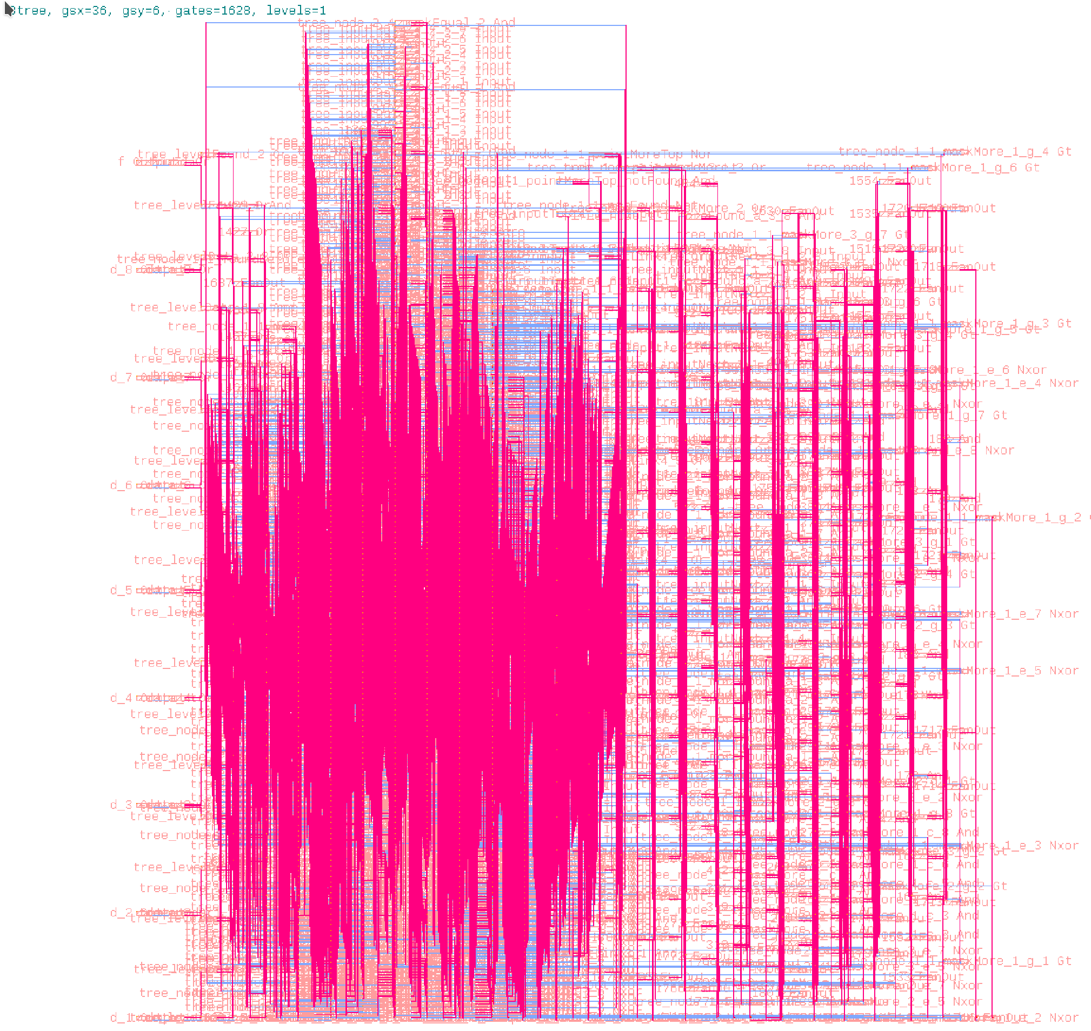
Here is our Silicon Chip designed for fast, efficient database lookups:

Slide 5
